Slide 1
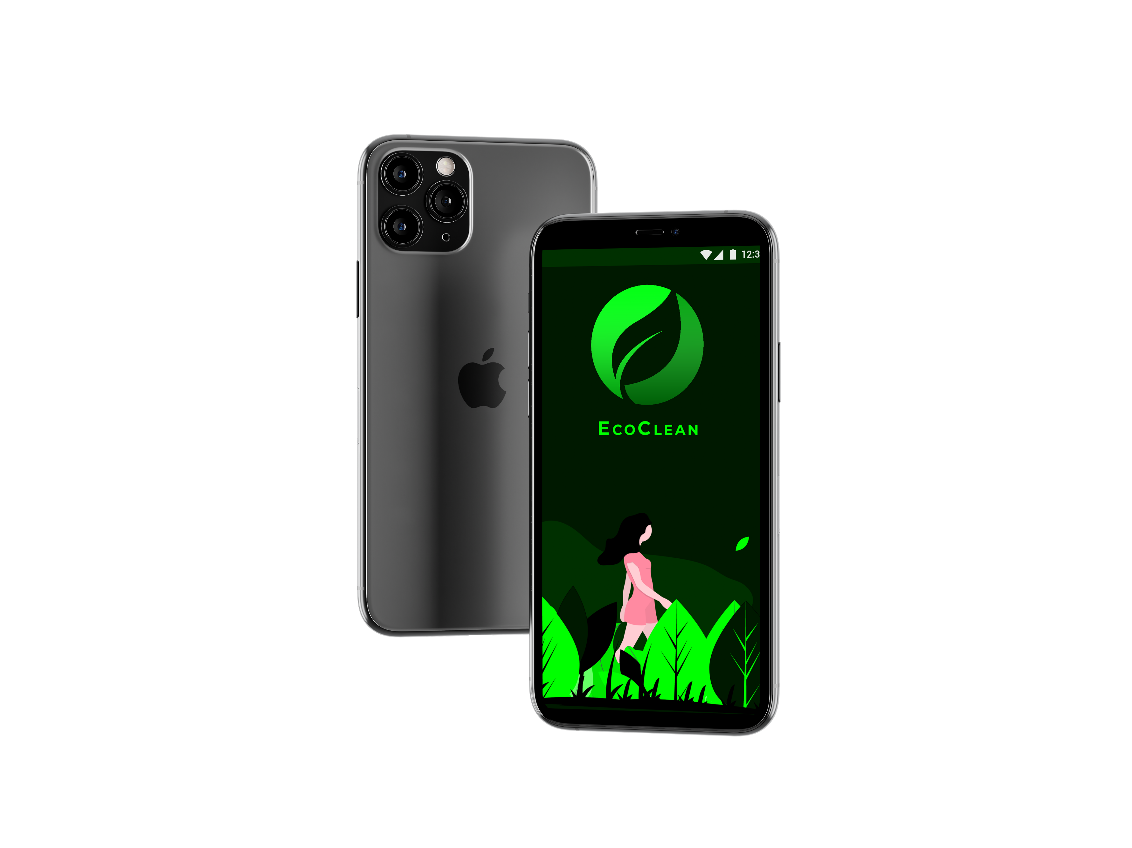
ECOCLEAN
TEAM ALPHA.

Slide 2
ABOUT US
1
Akarsh Ashok
2
Roncy R Thomas
3
Shan Shaji
TEAM ALPHA.
4
Tonal Mathew
5
Joel John Kandathil

Slide 3


Slide 4
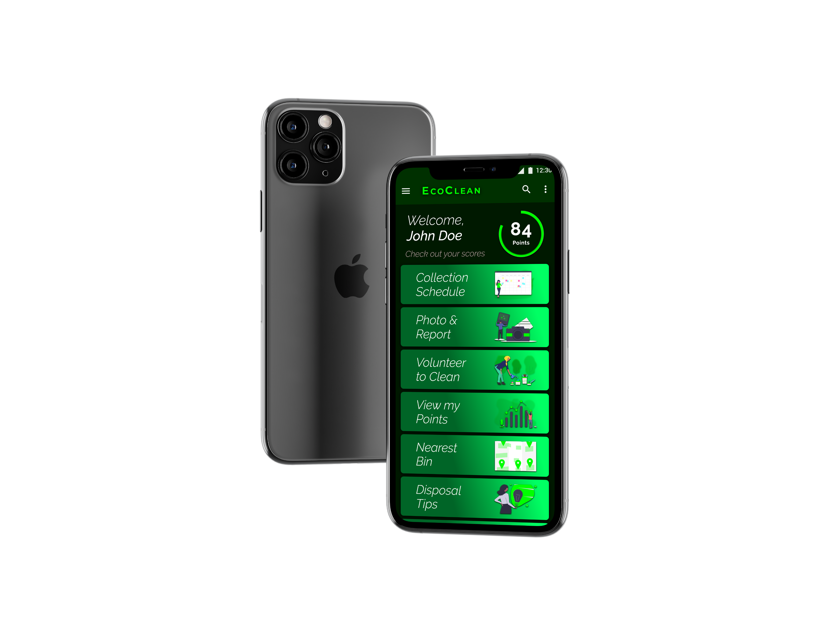
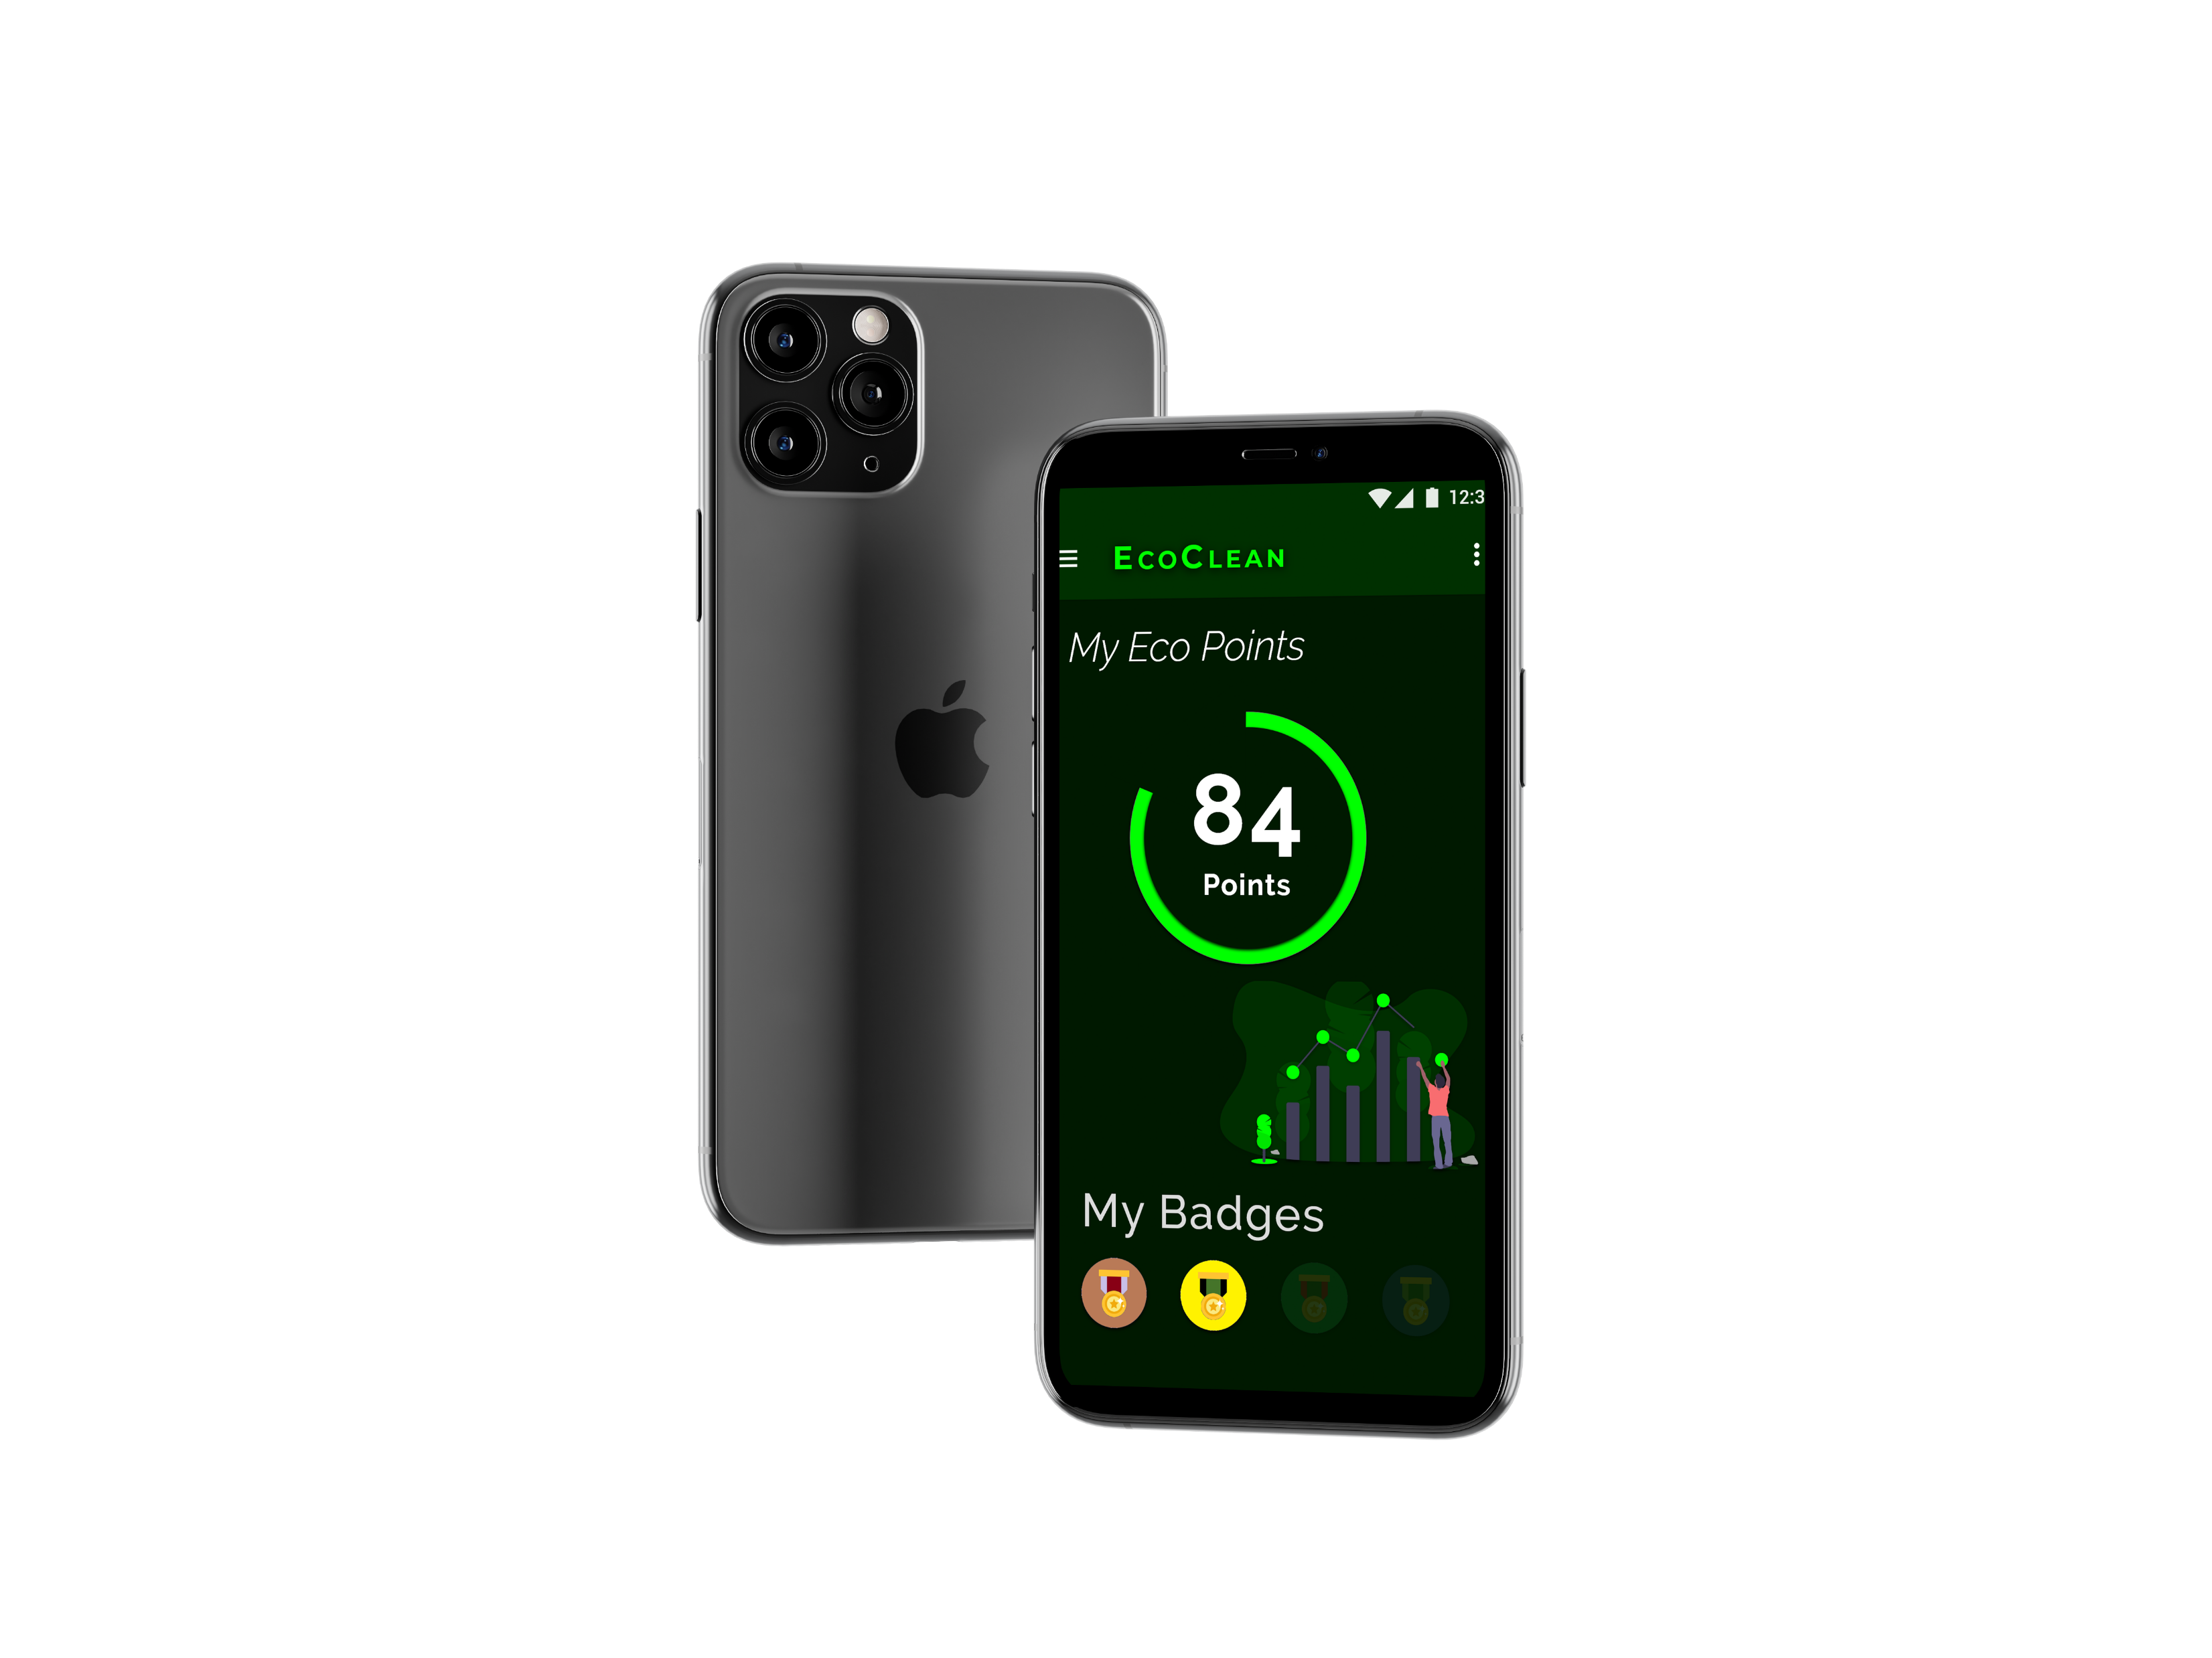
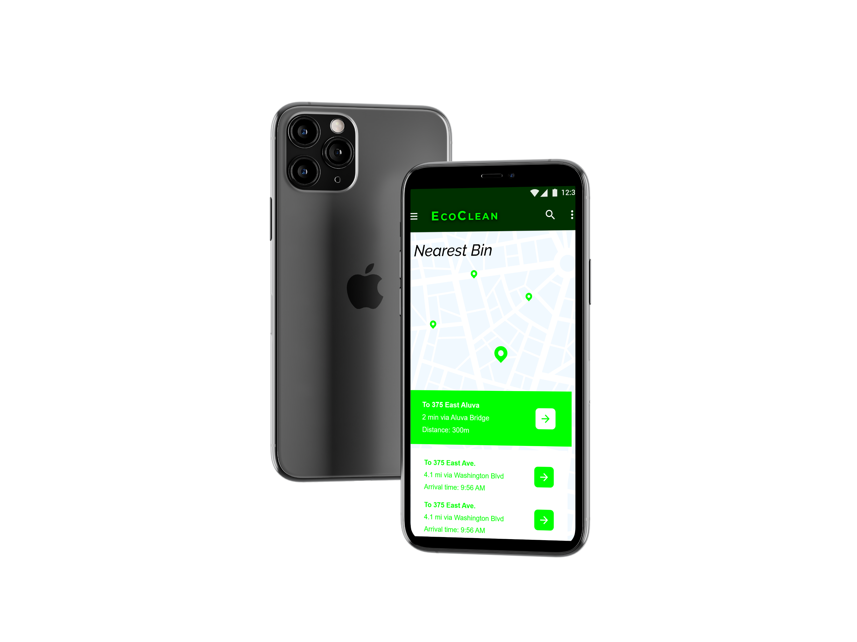
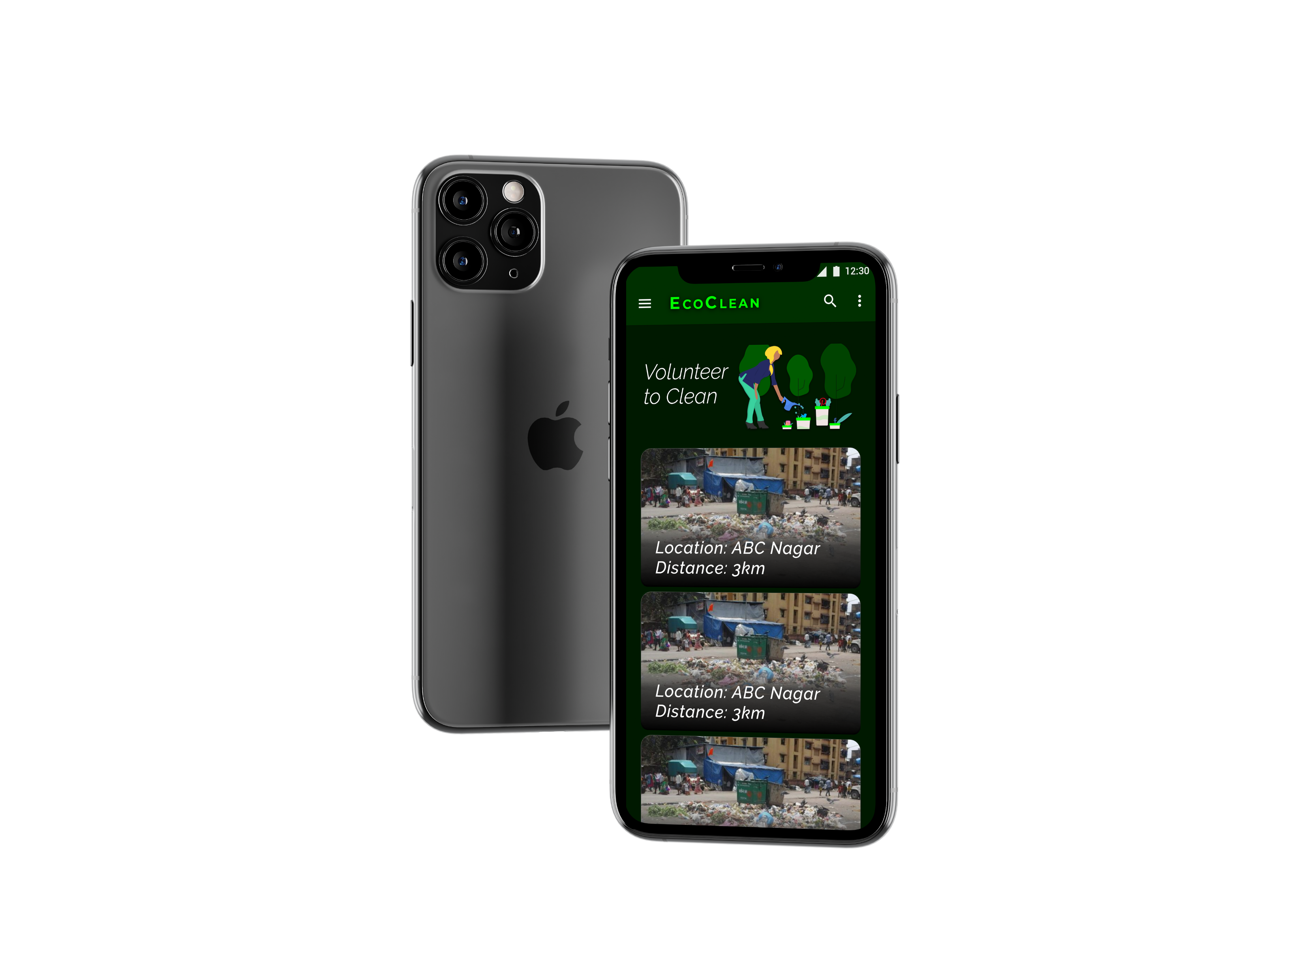
WHAT IS ECOCLEAN APP?

Slide 5
FUTURE SCOPE

Slide 6
THANK YOU!
Team Alpha.

